Slide 1
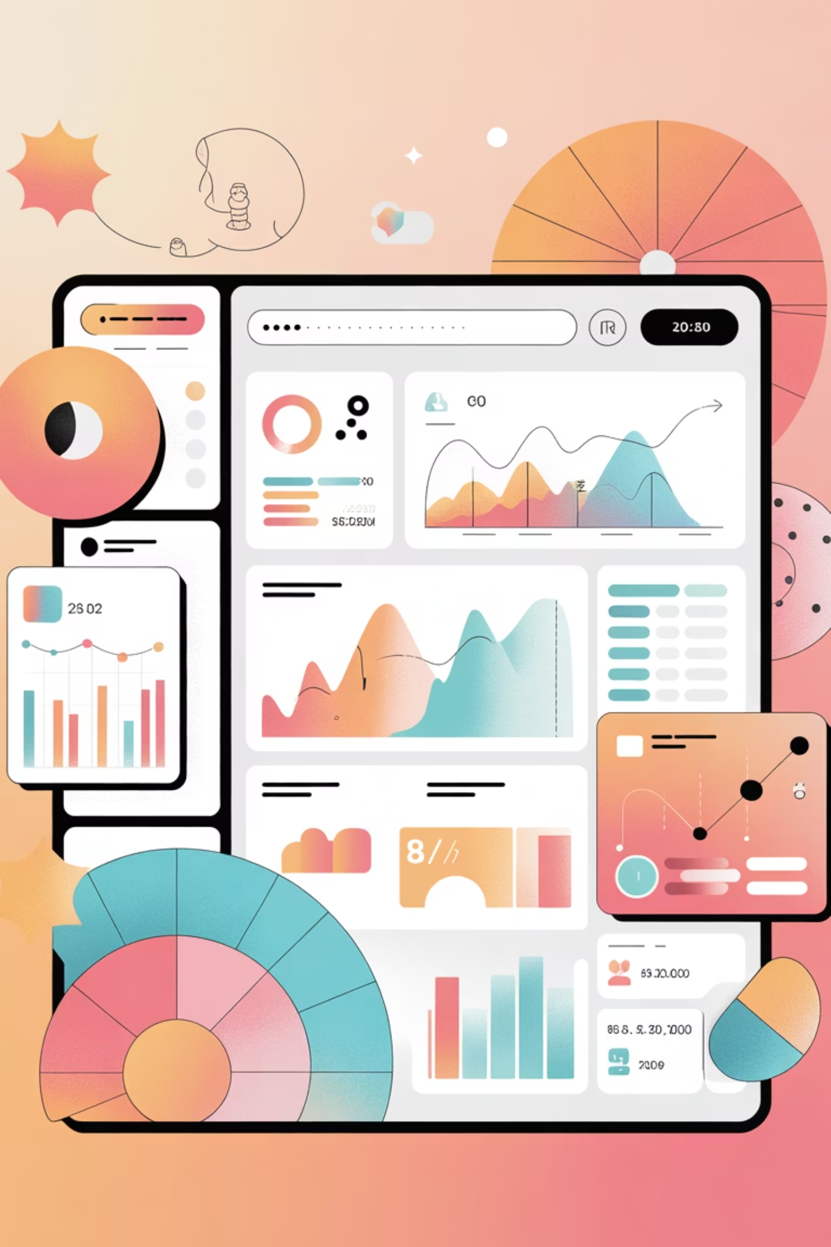

Transforming invoice management into a proactive, automated, and insight-driven process for enhanced financial health.
Automate Invoicing
Enable Proactive Controls
Drive Data Insights
Improve Financial Health

Slide 2

The Challenge: Manual Invoicing Bottlenecks
Delayed Payments
Manual Tracking
Limited Visibility
Impacting cash flow predictability and operational stability.
Inefficient invoice tracking and labor-intensive follow-ups.
Lack of real-time insights for timely management decisions.

Slide 3




The Solution: Automated Invoice Management
Our application provides a comprehensive platform for optimizing the entire invoice reminder process.
Centralized Validation
Streamlined invoice processing and tracking.
Automated Reminders
Proactive alerts and escalations for clients.
Real-time Dashboards
Instant access to critical financial data for leadership.

Slide 4
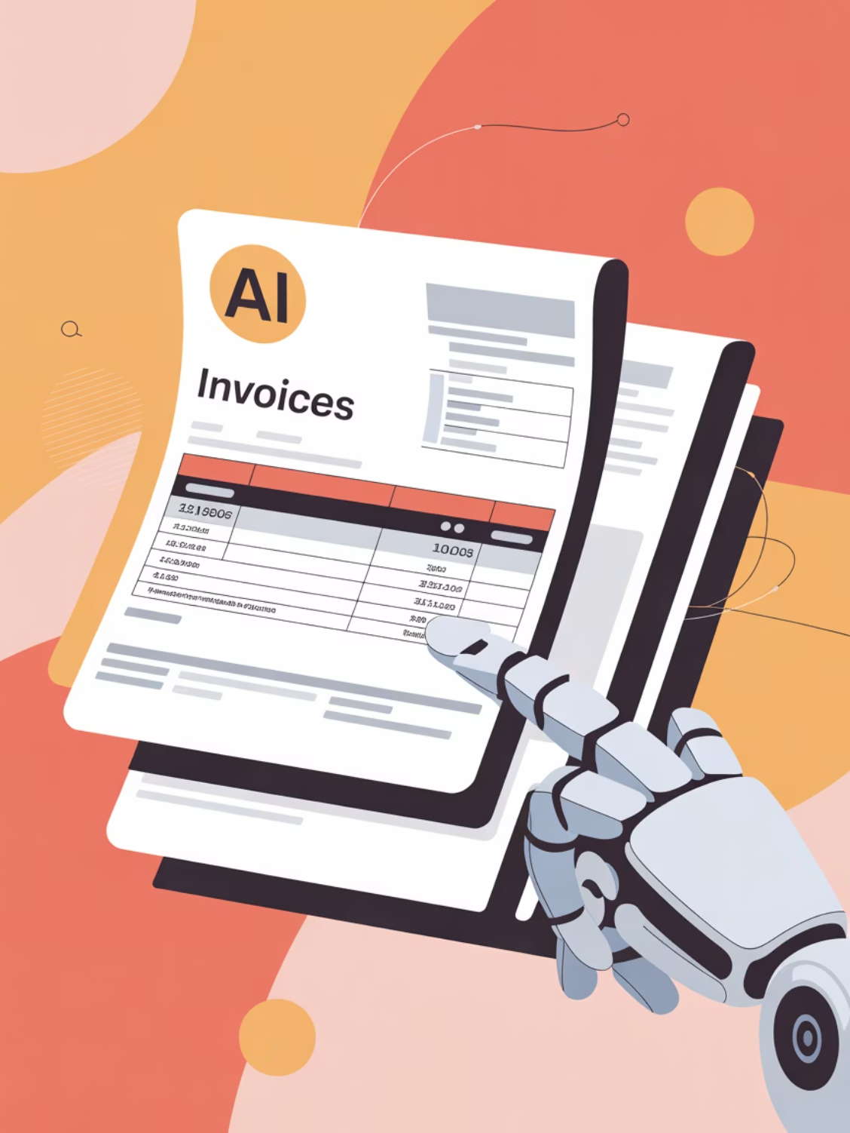
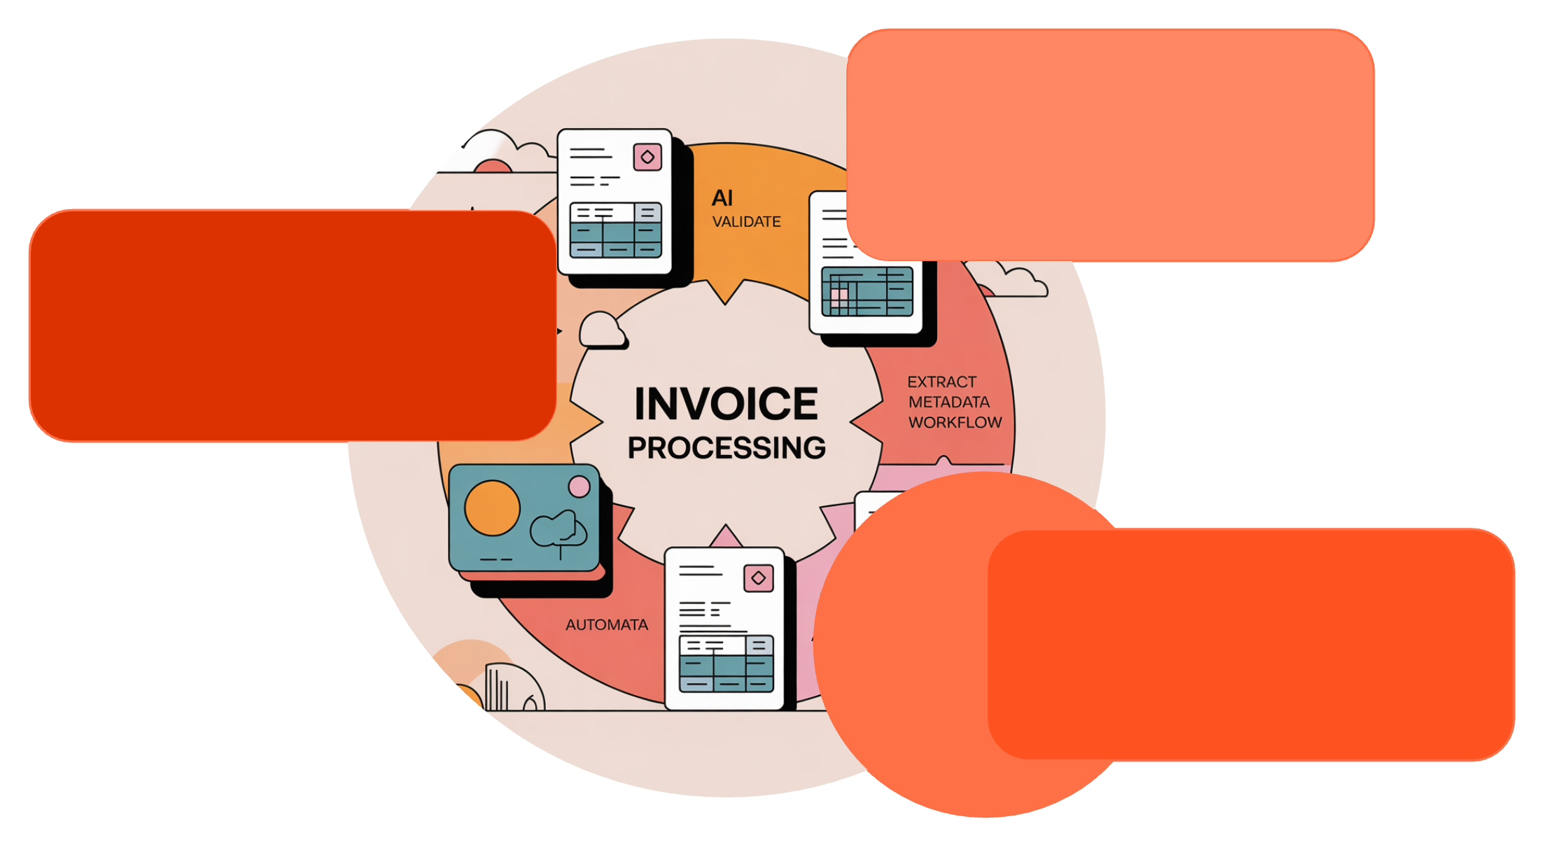
Intelligent Invoice Processing: Accuracy & Efficiency
Extract Metadata
Capture key invoice fields
Scan & Validate
AI checks invoice integrity
Identify Overdue
Flag late or missing payments
Our system leverages advanced AI to ensure accuracy and reduce manual intervention throughout the invoice lifecycle.

Slide 5

Smart Notification Engine: Contextual Communication
Our sophisticated engine ensures clients receive timely and relevant communications, enhancing payment compliance.
Notification Mapping: Applies customized alerts, reminders, and escalations.
Context-Aware Communication: Tailors messages for pre-due, post-due, and escalated scenarios.
Configurable Rules: Adapts to diverse client segments and payment terms.

Slide 6

Executive Financial Dashboard: Your Command Center
Gain instant, crystal-clear visibility into your firm's financial health.
1
2
3
Unified Fund Flow
Due vs. Overdue
Real-time Status
A single view of all incoming and outgoing funds.
Immediate identification of critical payment statuses.
Up-to-the-minute payment updates for proactive decisions.

Slide 7

Cash Flow & Financial Insights: Strategic Foresight
Empower leadership with predictive analytics and comprehensive financial breakdowns.
Cashflow Projections: Forecast future liquidity with higher accuracy.
Monthly Financial Breakdown: Detailed analysis of revenue and expenses.
Trend-Based Charts: Visual data for informed strategic decision-making.

Slide 8

Operational Transparency: Optimize Performance
Monitor key operational metrics to continuously improve processes and client satisfaction.
1
2
Invoice Overview
Notification Status
Comprehensive view of total clients and outstanding invoices.
Track pending, failed, and successful communication events.
3
Actionable Insights
Data-driven recommendations for finance teams to refine strategies.

Slide 9

Tangible Business Value to Management
Accelerated Payment Cycles
Significantly reduce days sales outstanding (DSO).
Enhanced Cash Flow Forecasting
Greater predictability for strategic financial planning.
Reduced Manual Effort
Free up finance teams for higher-value activities.
Improved Client Relations
Professional, consistent, and timely communication.

Slide 10

Commercial Readiness & Scalability
Our application is engineered for enterprise-grade performance and broad market adoption.
Cloud-Native Architecture
Flexible Configuration
Customizable notification rules to meet diverse business needs.
Built on a scalable, secure, and robust cloud infrastructure.
Multi-Industry Deployment
Designed for seamless integration across various client bases and sectors.

